Slide 1
TFIP-AI – Advanced Machine Learning
Unit 1 Support Vector Machine

Slide 2
Outline
Unit 1 – Support Vector Machine
Unit 2 – Clustering-1
Unit 3 – Clustering-2
Unit 4 – Dimensionality Reduction

Slide 3
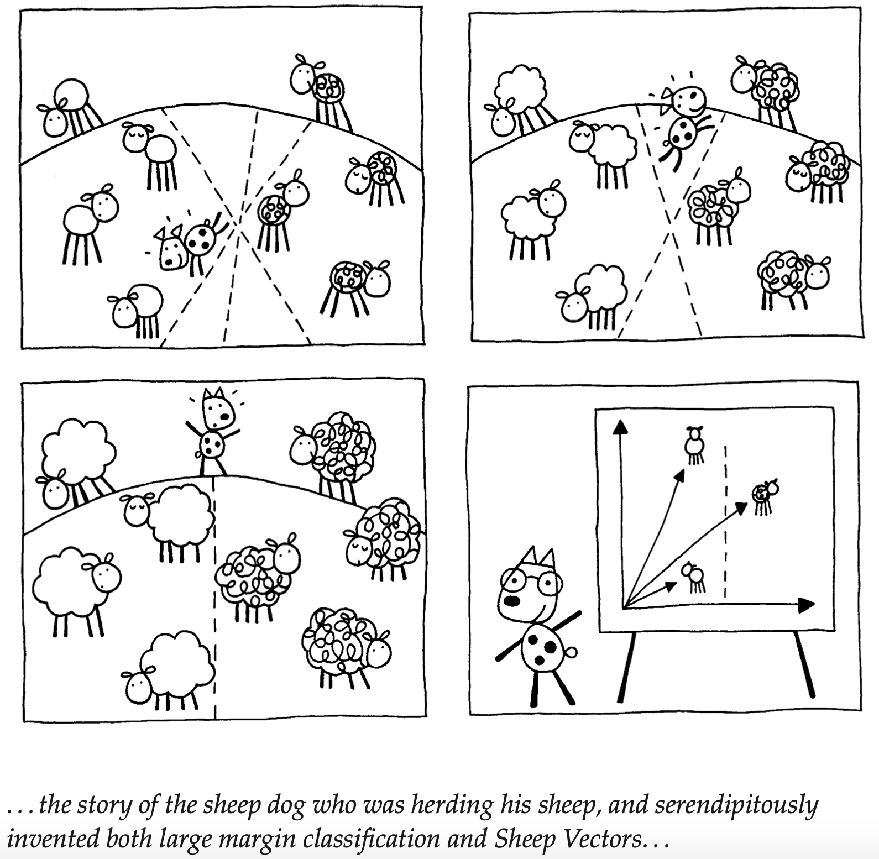

Slide 4
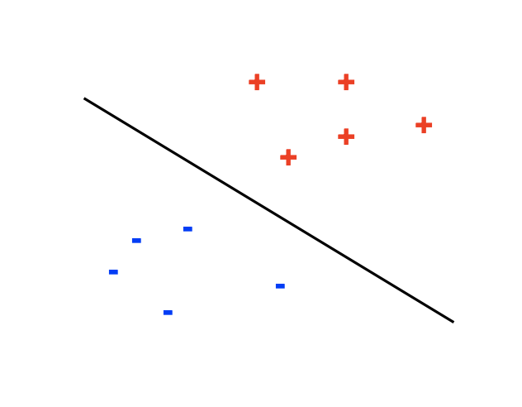
Find a linear separator with the largest margin

Slide 5
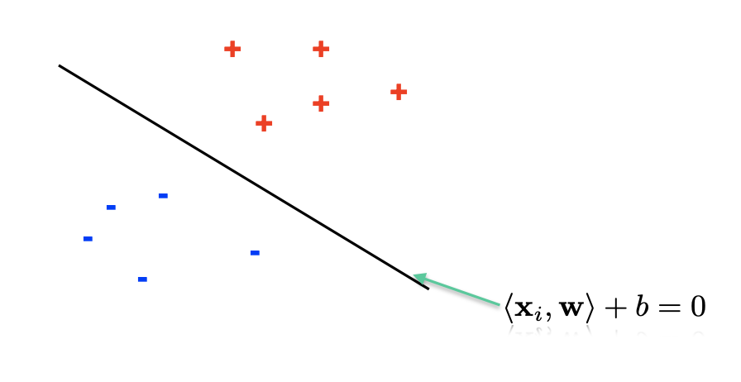
Find a linear separator with the largest margin cont...

Slide 6
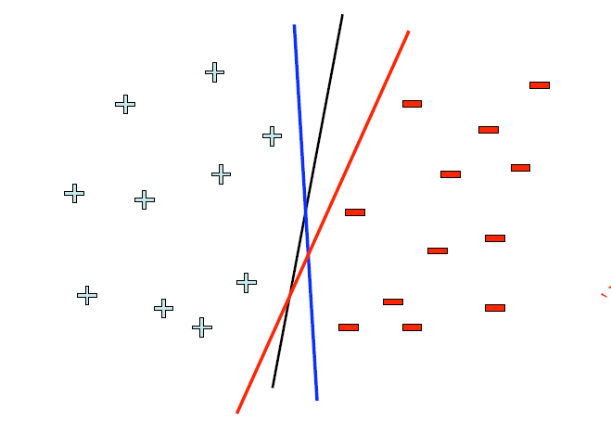
Linear Classifier – which line is better?
Pick the one with the largest margin!

Slide 7
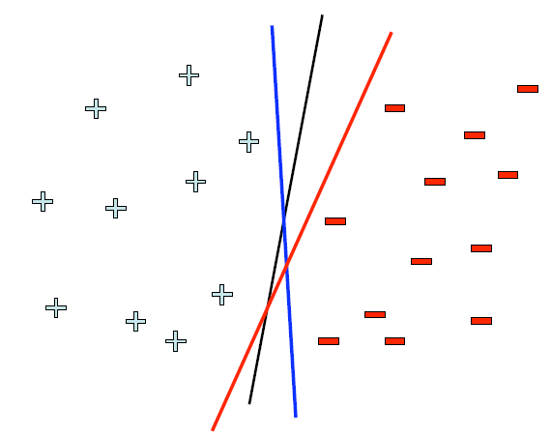

Linear Classifier – which line is better?
Pick the one with the largest margin!

Slide 8
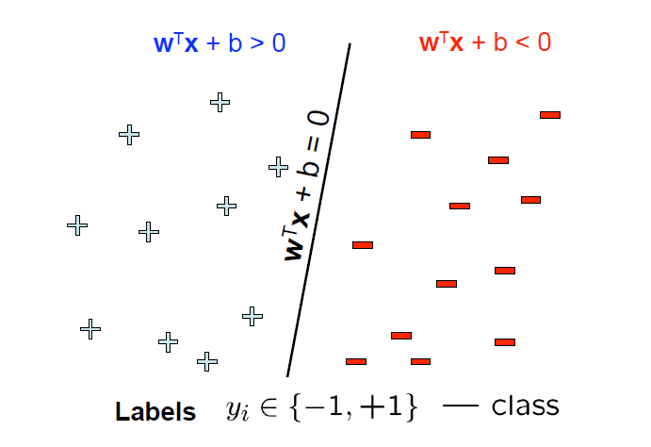
Parameterizing the decision boundary
Y: Set of wrong classified samples

Slide 9
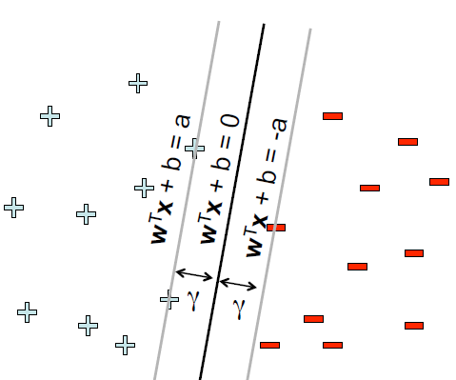
Maximizing the margin
Margin = Distance of
closest examples
from the decision line/
hyperplane

Slide 10
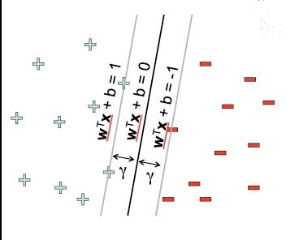
Support Vector Machine
Solve efficiently by quadratic programming (QP)
Which includes well-studied solution algorithms

Slide 11
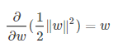
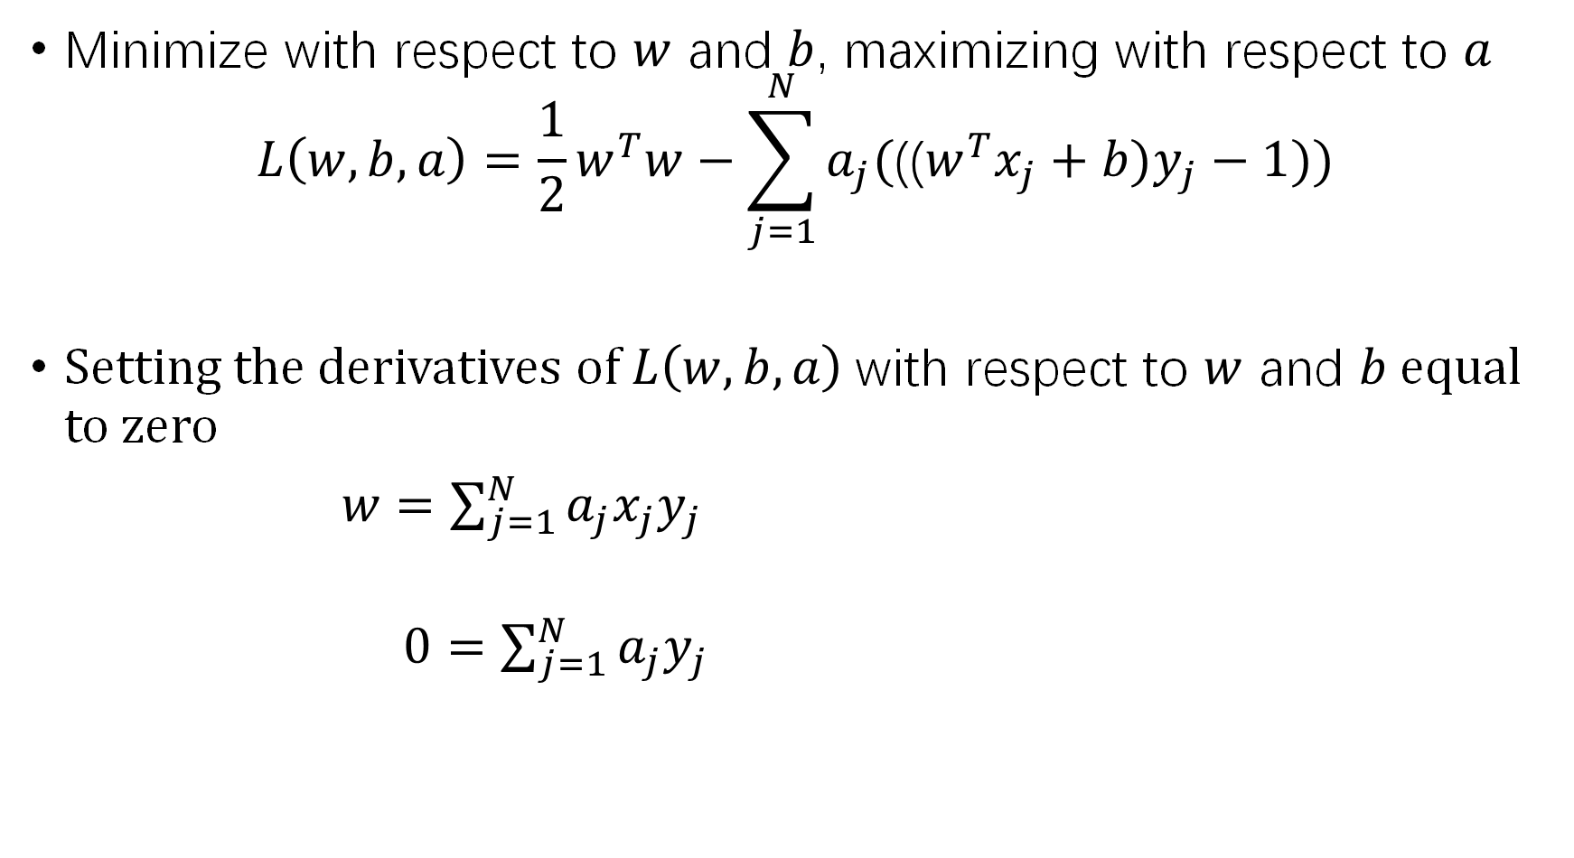
Minimize with respect to $w$ and $b$, maximizing with respect to $a$
$$L\left(w,b,a\right)=\frac{1}{2}w^{T}w−\sum_{j=1}^{N}{a_{j}(\text{((}w^{T}x_{j}+b)y_{j}−1))}$$
Setting the derivatives of $L\left(w,b,a\right)$ with respect to $w$ and $b$ equal to zero
$w=\sum_{j=1}^{N}{a_{j}x_{j}y_{j}}$
$0=\sum_{j=1}^{N}{a_{j}y_{j}}$

Slide 12
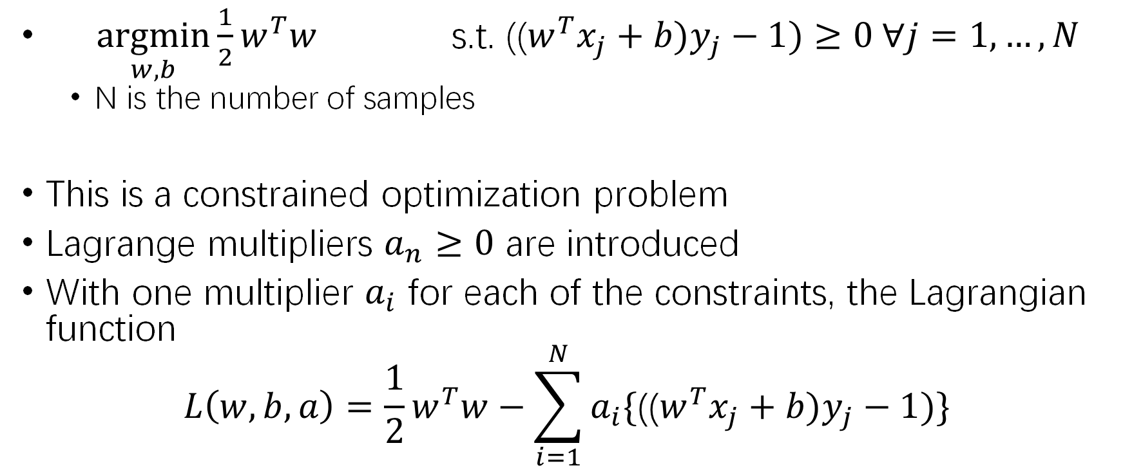
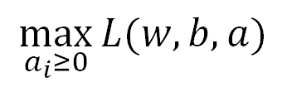
Lagrange multipliers
$\underset{w,b}{argmin}{\frac{1}{2}w^{T}w}$ s.t. (($w^{T}x_{j}+b)y_{j}−1)≥0 ∀j=1,…, N$
N is the number of samples
This is a constrained optimization problem
Lagrange multipliers $a_{n}≥0$ are introduced
With one multiplier $a_{i}$ for each of the constraints, the Lagrangian function
$$L\left(w,b,a\right)=\frac{1}{2}w^{T}w−\sum_{i=1}^{N}{a_{i}\{\text{((}w^{T}x_{j}+b)y_{j}−1)\}}$$
$$\max_{a_{i}≥0}{L(w,b,a)}$$

Slide 13
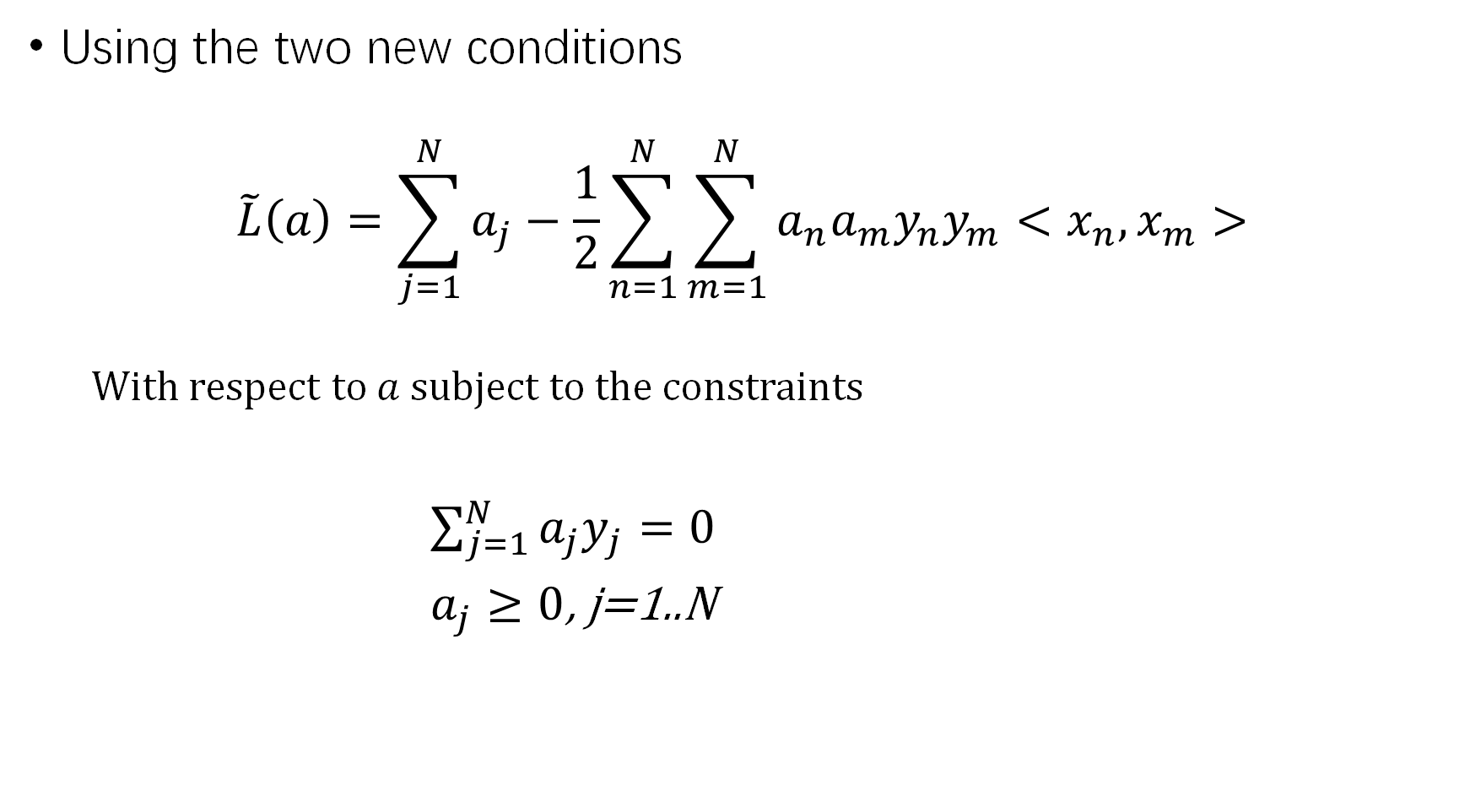
Using the two new conditions
$$\tilde{L}\left(a\right)=\sum_{j=1}^{N}{a_{j}}−\frac{1}{2}\sum_{n=1}^{N}{\sum_{m=1}^{N}{a_{n}a_{m}y_{n}y_{m}<x_{n},x_{m}>}}$$
With respect to $a$ subject to the constraints
$\sum_{j=1}^{N}{a_{j}y_{j}}=0$
$a_{j}≥0$, j=1..N

Slide 14
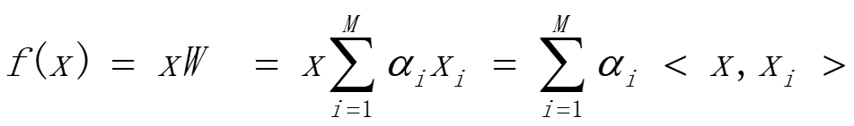
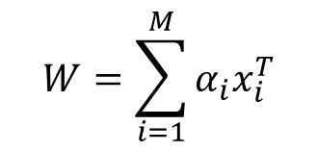
Linear Regression – dual form
$$W=\sum_{i=1}^{M}{α_{i}x_{i}^{T}}$$
Model
Solution
Learning Step: K=XX^{T} ( K_{ij} = <x_{i},x_{j}> dot product)
Testing Step: <x_{new}, x_{i}>
Both steps only involve dot product between data points

Slide 15
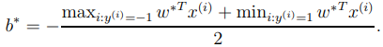
Support Vector Machine – 2 forms
Solve for w,b
Classification test for new sample
Solve for
Classification test for new sample
both are QP problems: SMO alg.

Slide 16
Support Vectors
Linear hyperplane defined by “support vectors”
Moving other points a little doesn’t affect the decision boundary
only need to store the support vectors to predict labels of new points

Slide 17
Kernel SVM
The dual form depends only on inner products, we can apply
the kernel trick to work in a (virtual) projected space
Learning
Classification
Learning
Classification

Slide 18
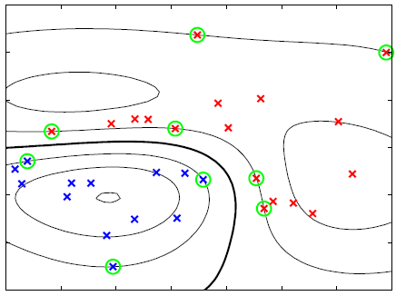
SVM Decision Surface using Gaussian Kernel
Circled points are the support vectors
Points plotted in original 2-D space.

Slide 19
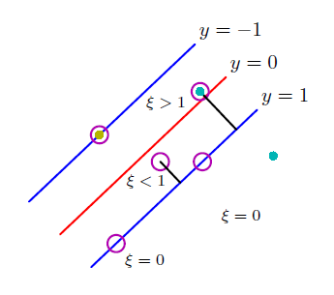
Soft margin SVM
QP problems
Slack Variable

Slide 20
Soft Margin SVM – 2 forms
Solve for w,b
Solve for
Both are QP problems

Slide 21
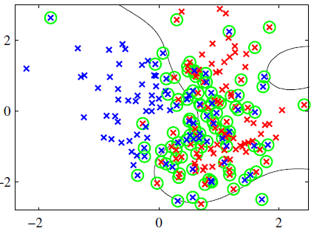
SVM Soft Margin Decision Surface using Gaussian Kernel
Circled points are the support vectors
Points plotted in original 2-D space.

Slide 22
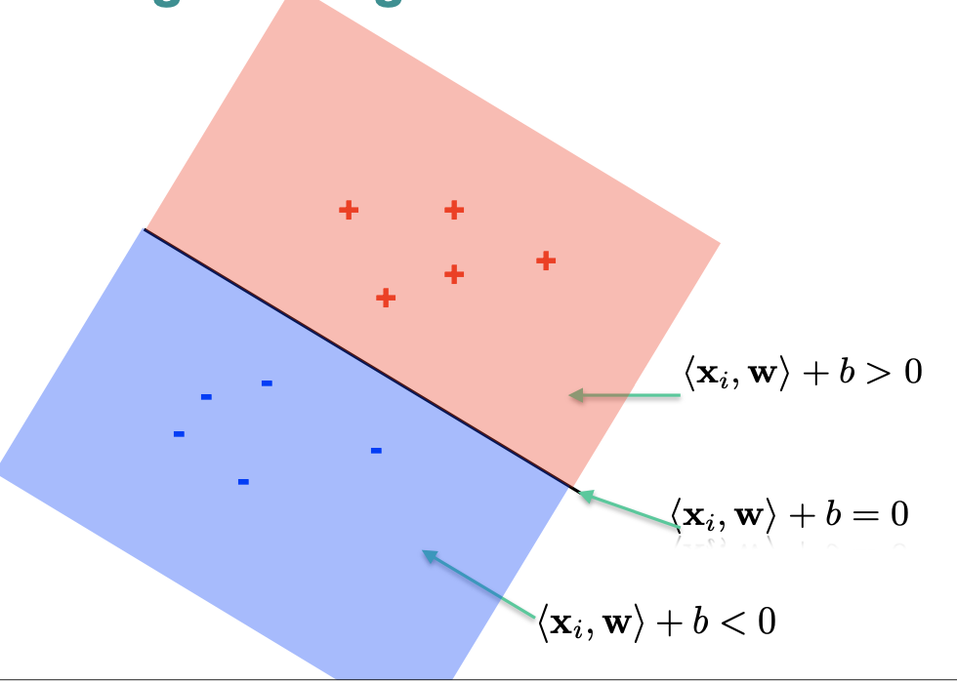
Find a linear separator with the largest margin cont...

Slide 23
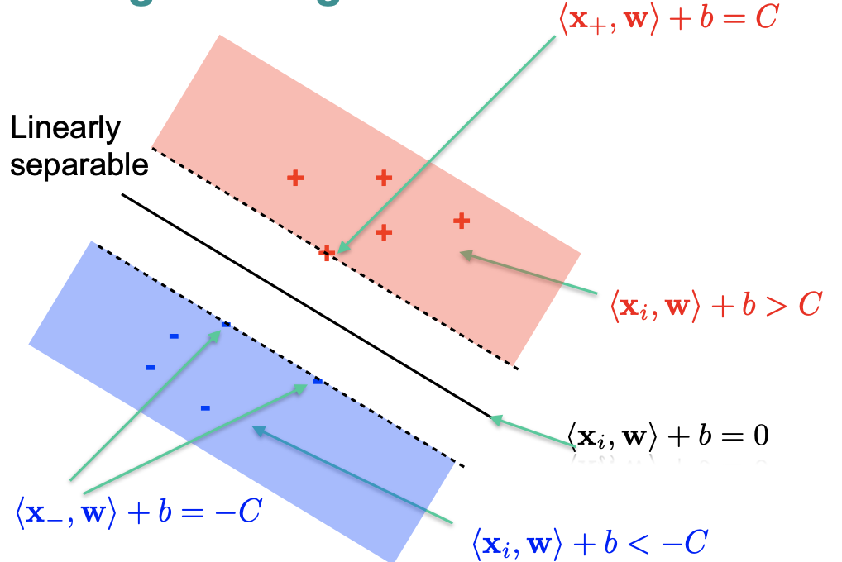
Find a linear separator with the largest margin cont...

Slide 24
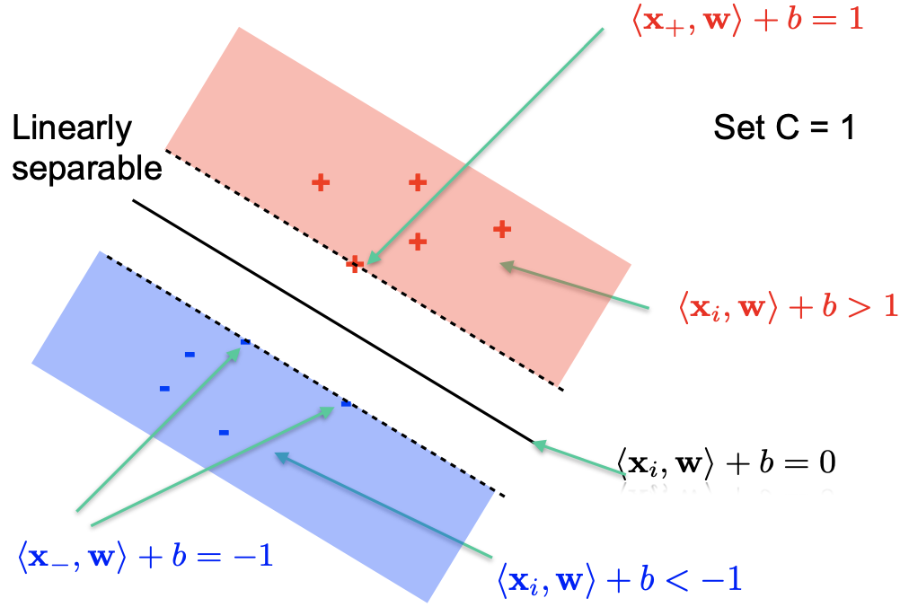
Find a linear separator with the largest margin cont...

Slide 25
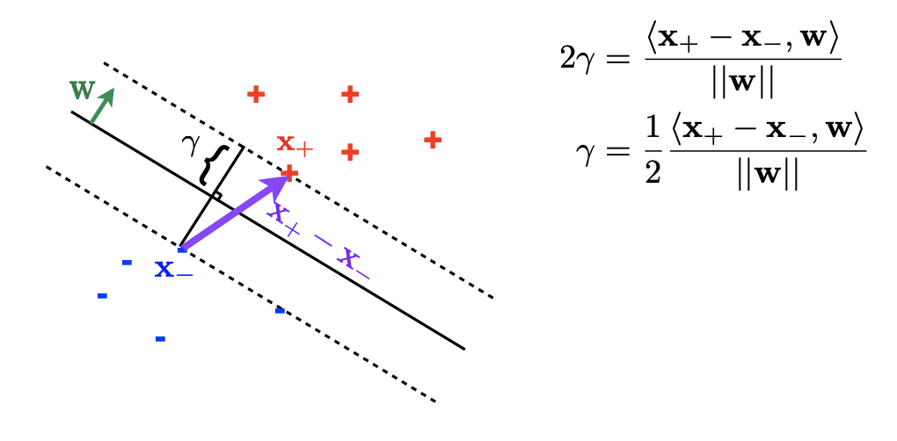
Find a linear separator with the largest margin cont...

Slide 26
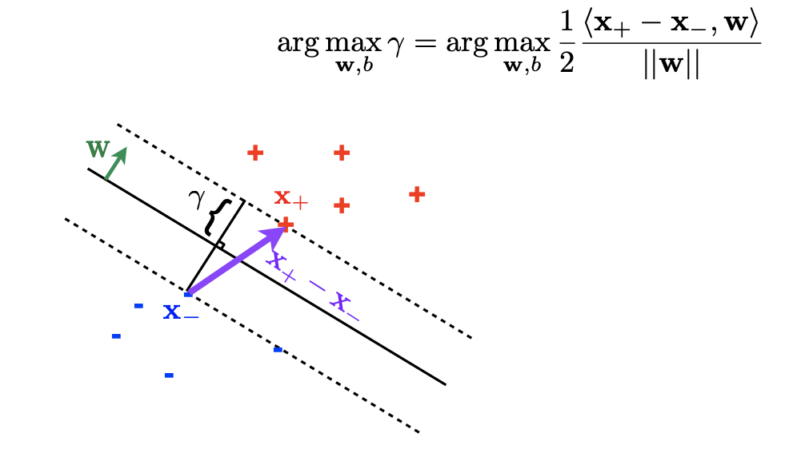
Find a linear separator with the largest margin cont...

Slide 27
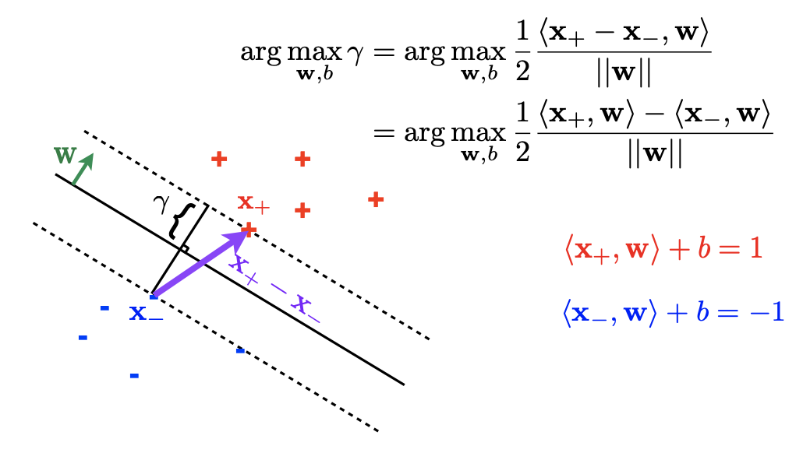
Find a linear separator with the largest margin cont...

Slide 28
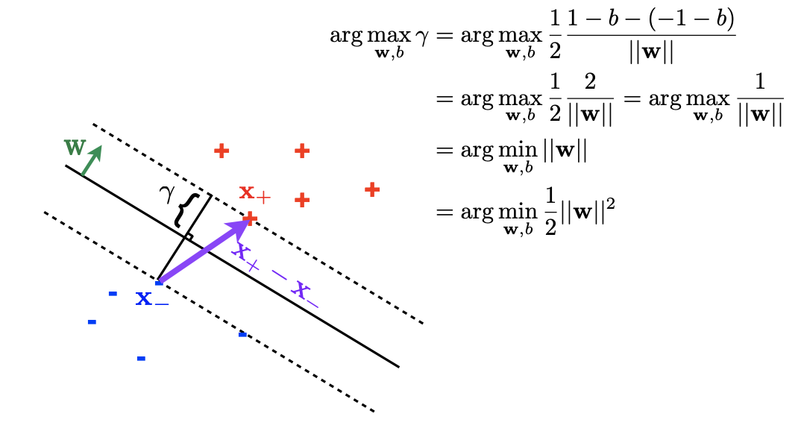
Find a linear separator with the largest margin cont...

Slide 29
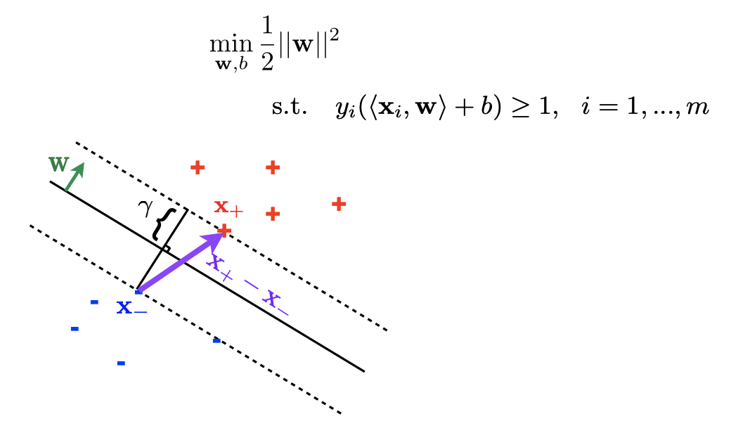
The (primal) optimization problem is:

Slide 30
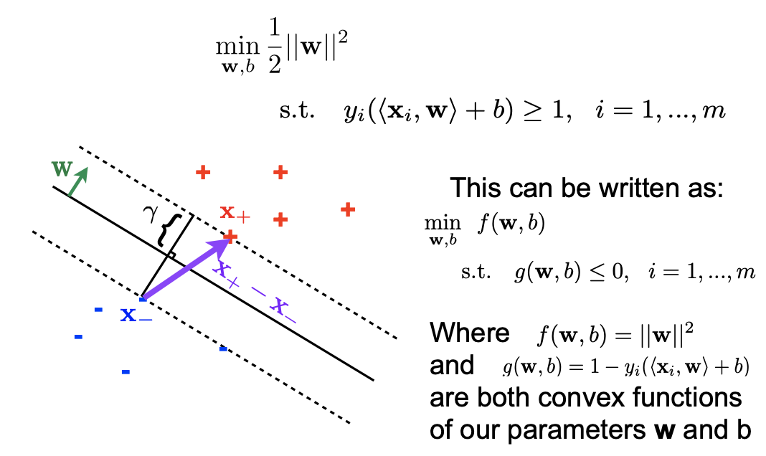
The (primal) optimization problem is: (cont...)

Slide 31
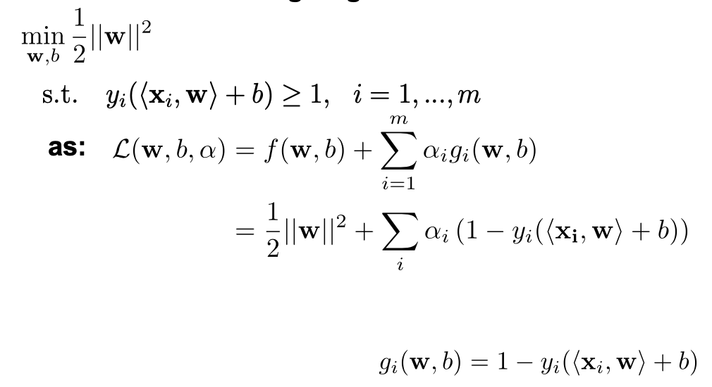
Lagrangian
We can write the Lagrangian of:

Slide 32
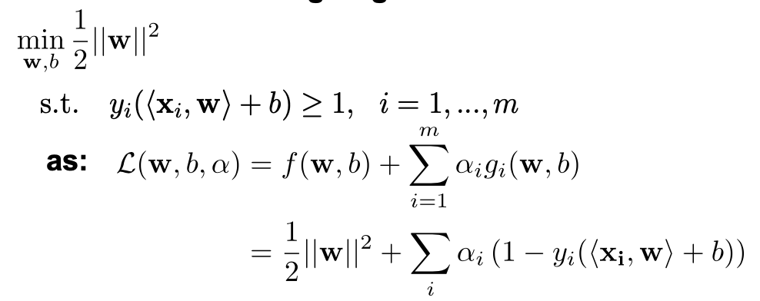
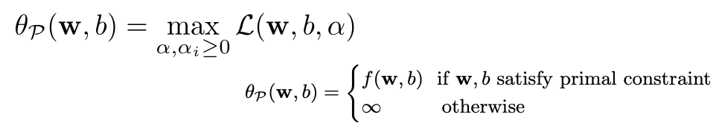
Lagrangian
We can write the Lagrangian of:
Take the quantity:

Slide 33
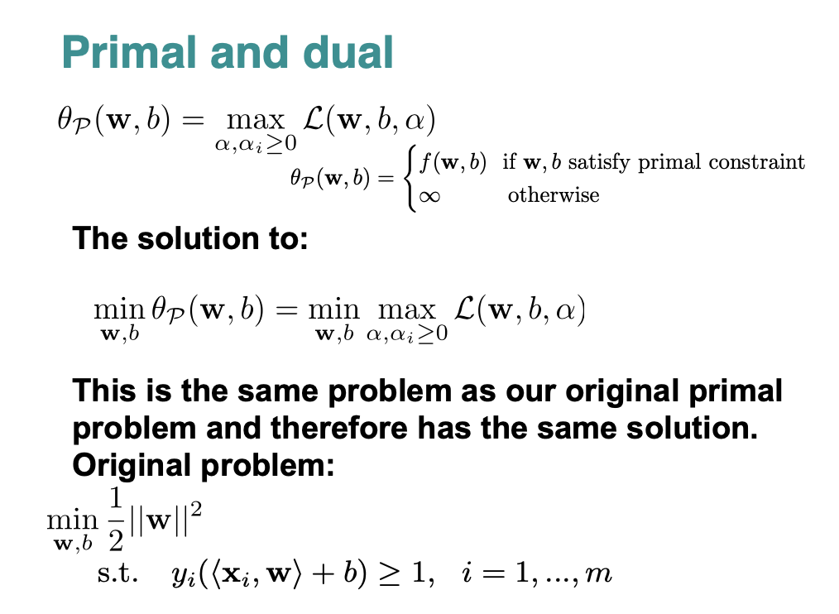

Slide 34
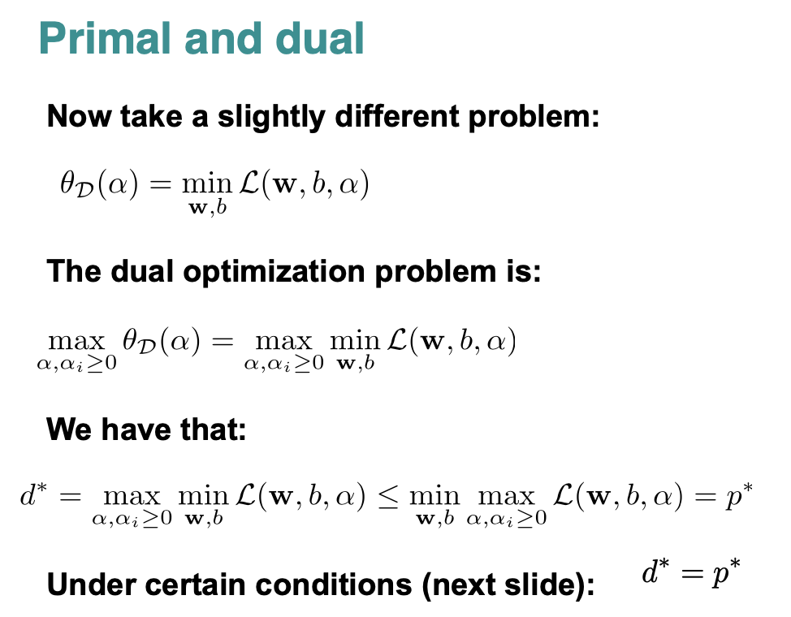

Slide 35
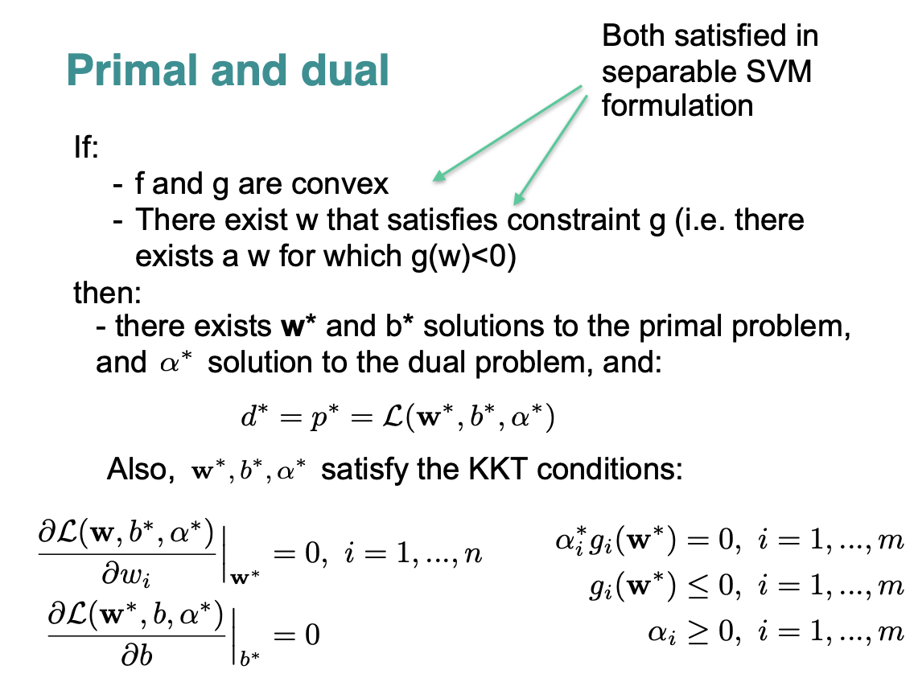

Slide 36
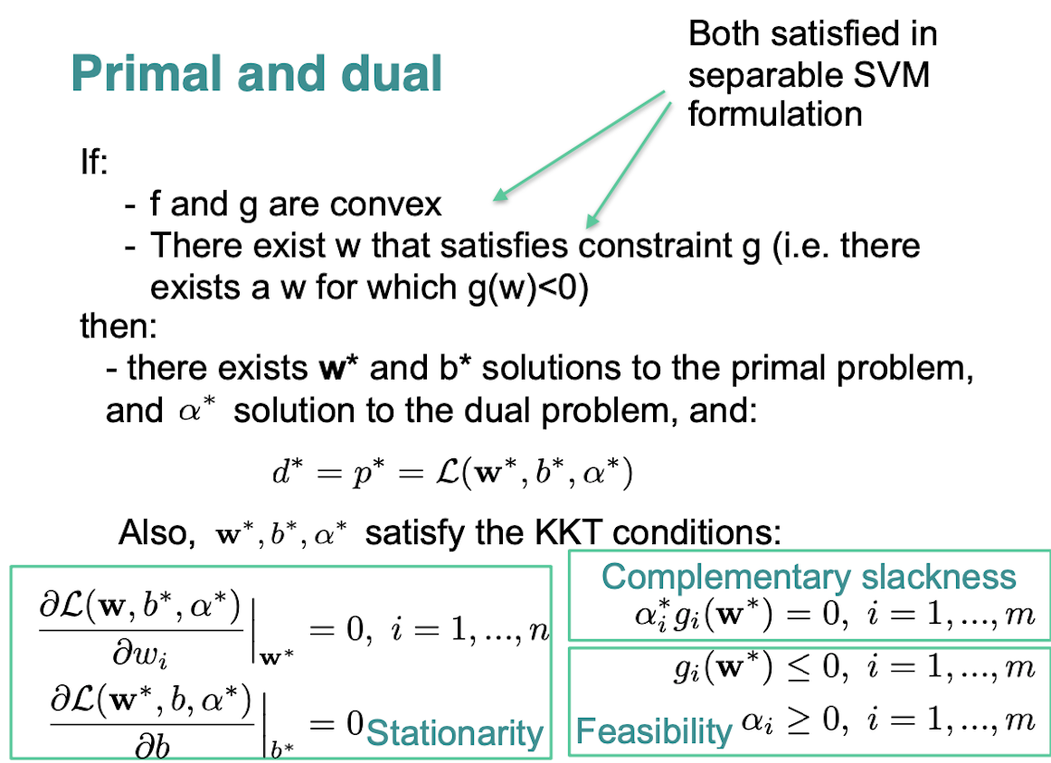

Slide 37
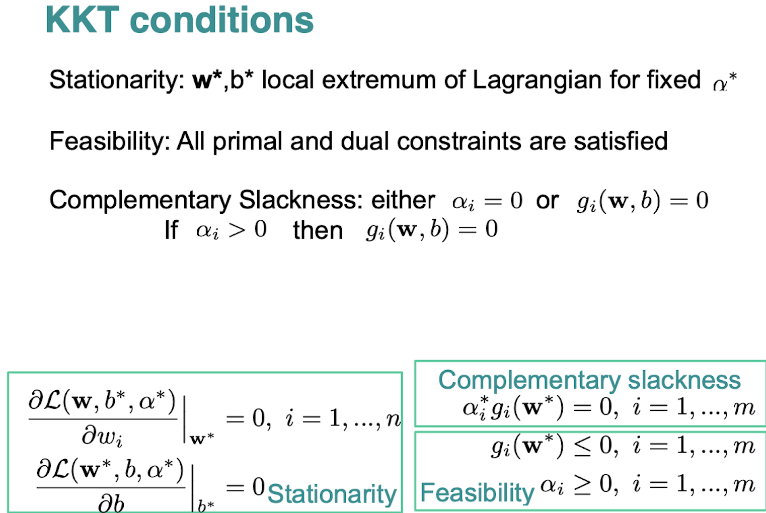

Slide 38
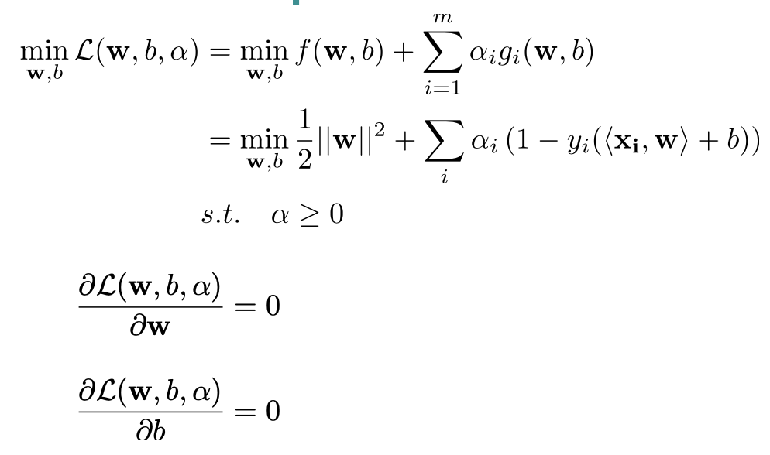
Solve the dual problem. First solve:

Slide 39
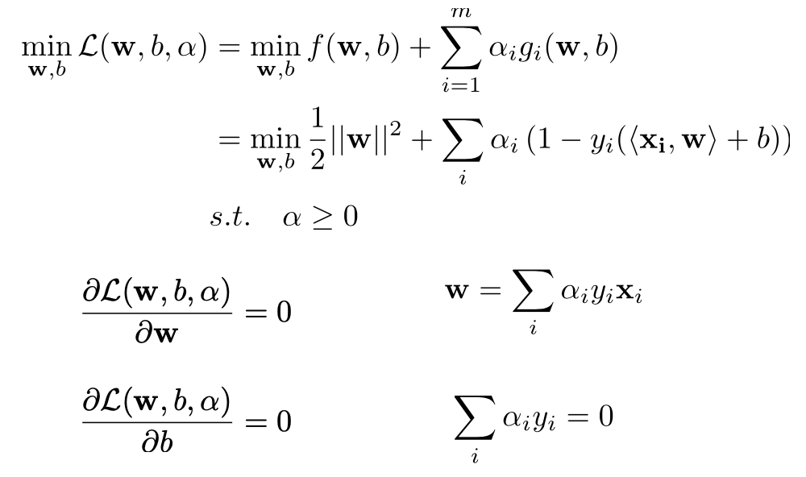
Solve the dual problem. First solve (cont...):

Slide 40
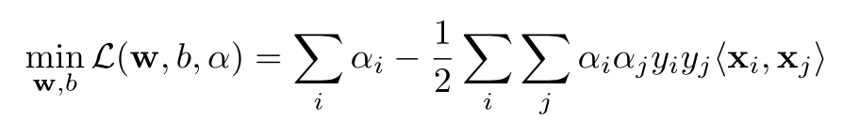
Then replace:

Slide 41
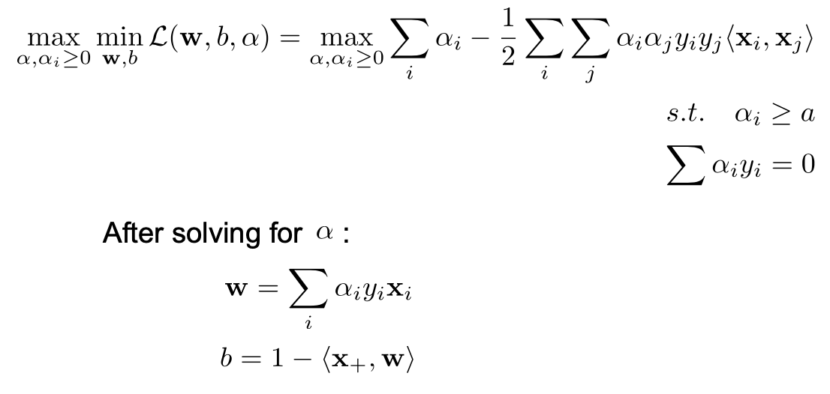
Then solve:

Slide 42
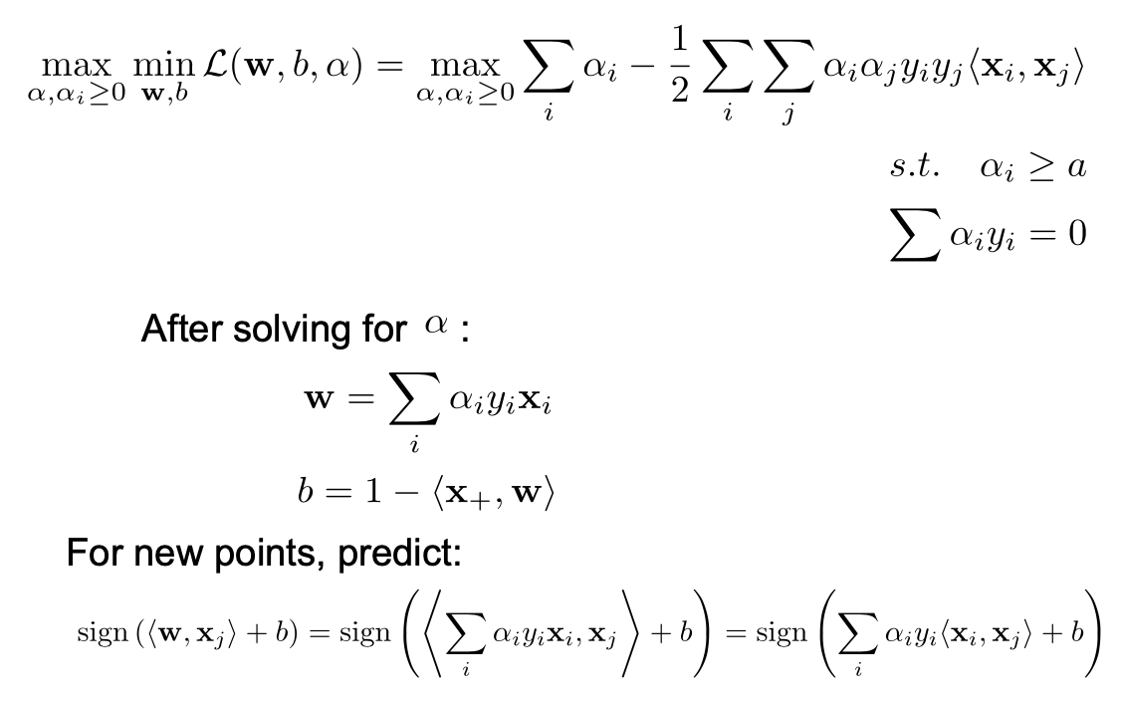
Then solve (cont...):

Slide 43
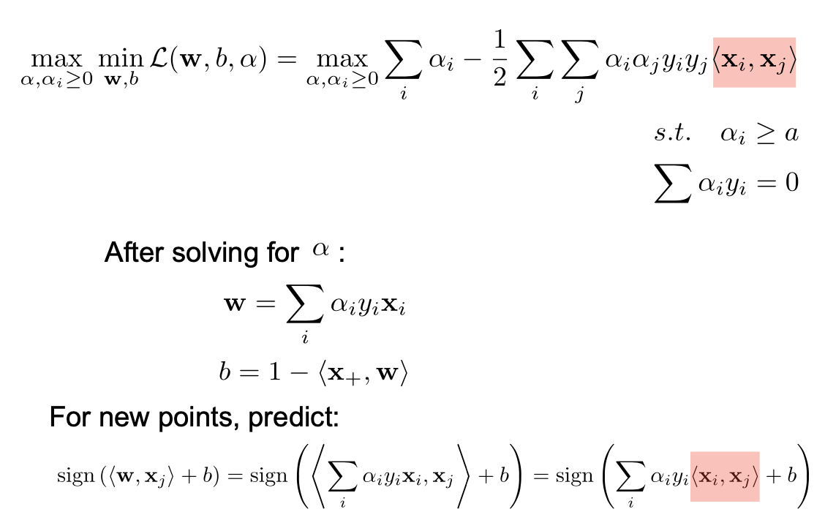
Then solve (cont...):

Slide 44
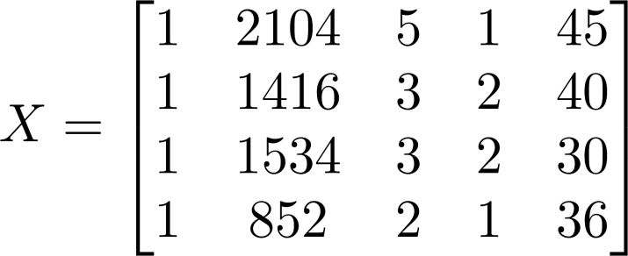
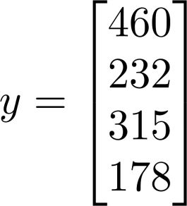
Linear Regression with multiple variables
 | Size (feet²) | Number of bedrooms | Number of floors | Age of home (years) | Price ($1000)
1 | 2104 | 5 | 1 | 45 | 460
1 | 1416 | 3 | 2 | 40 | 232
1 | 1534 | 3 | 2 | 30 | 315
1 | 852 | 2 | 1 | 36 | 178

Slide 45
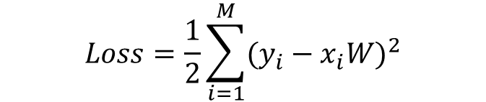
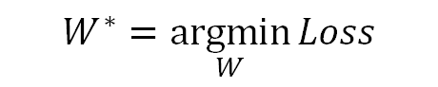
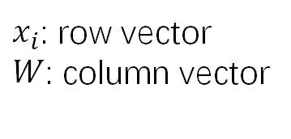
Linear Regression with multiple variables -- Normal Equation
$$Loss=\frac{1}{2}\sum_{i=1}^{M}{{(y_{i}−x_{i}W)}^{2}}$$
$x_{i}$: row vector
$W$: column vector
$$W^{∗}=\underset{W}{argmin}{Loss}$$

Slide 46
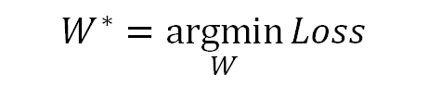
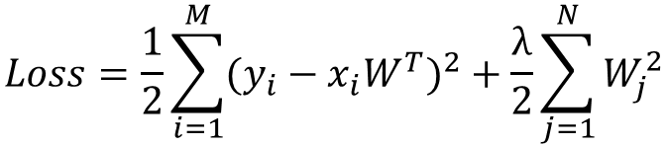
Linear Regression with multiple variables -- Regularized Least Squares
To control over fitting
Regularization
Discourage the coefficients from reaching large values.
$$Loss=\frac{1}{2}\sum_{i=1}^{M}{{(y_{i}−x_{i}W^{T})}^{2}}+\frac{λ}{2}\sum_{j=1}^{N}{W_{j}^{2}}$$
$$W^{∗}=\underset{W}{argmin}{Loss}$$

Slide 47
W: linear combination of the training examples
(1)
(2)
Substitute W with (1)

Slide 48
New parameters for LR

Slide 49
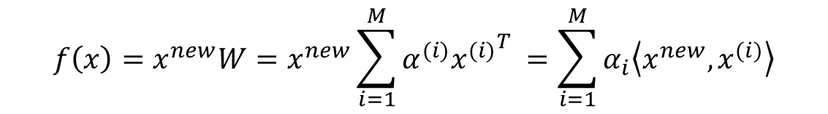
Linear Regression – dual form
$$f\left(x\right)=x^{new}W=x^{new}\sum_{i=1}^{M}{α^{(i)}{x^{(i)}}_{}^{T}}=\sum_{i=1}^{M}{α_{i}\left\langle x^{new},x^{(i)}\right\rangle }$$
Model
Solution
Learning Step: K=XX^{T} ( K_{ij} = <x_{i},x_{j}> dot product)
Testing Step: <x_{new}, x_{i}>
Both steps only involve dot product of two data points

Slide 50
Dual form opens a door to Kernel Function
Since the computation only involves dot products
All <.,.> can be replaced by a kernel function
Original Space
Projected Space (higher dimensional)

Slide 51


Slide 52
Quadratic Kernel Function
Suppose we have data originally in 2D, but project it into 3D using
the following kernel function can be used to calculate inner products in the projected 3D space, in terms of operations in the 2D space

Slide 53
Quadratic Kernel Function in use
Use Quadratic Kernel Function to train and apply our regression function, never leaving 2D space
Training
Applying

Slide 54
Our gain from the “Kernel Trick”
Training Data: 1000 images, each 32*32=1024 pixels, 1024-d
By using Quadratic Kernel, we implement linear regression in a much higher space,
But actually using less computation for the learning phase than we did in the original space
Original space: inverse of a 1024*1024 matrix
Higher dim space with kernel trick: inverse of a 1000*1000 matrix

Slide 55




Common Kernels
Polynomials of degree d
Polynomials of degree up to d
Gaussian/Radial kernels (polynomials of all orders – projected space has infinite dimension)
Sigmoid

Slide 56
Which function can be kernels?
not all functions
for some definitions of k(x1,x2) there is no corresponding projection ϕ(x)
Nice theory on this, including how to construct new kernels from existing ones
Initially kernels were defined over data points in Euclidean space, but more recently over strings, over trees, over graphs, …
Kernel methods for pattern analysis J. S.T and N.C. Cambridge University Press, 2004.

Slide 57
Key points on Kernel Functions
Many learning tasks are framed as optimization problems
Dual version framed in terms of dot products between x’s
Kernel functions k(x,y) allow calculating dot products <Φ(x),Φ(y)> without bothering to project x into Φ(x)
Leads to major efficiencies, and ability to use very high dimensional (virtual) feature spaces

Slide 58

Kernels

Slide 59

Example kernel

Slide 60

Example kernel (cont...)

Slide 61

Please verify yourself:

Slide 62

Please verify yourself (cont...):

Slide 63

Please verify yourself (cont...):

Slide 64

Please verify yourself (cont...):

Slide 65

Please verify yourself (cont...):

Slide 66

For new points:

Slide 67

For new points (cont...):

Slide 68

The kernel trick

Slide 69

Learn non-linear boundaries

Slide 70

Learn non-linear boundaries cont...

